Slide 1
Ger’s Garage WebSystem
Eduardo Kenji Zen Nakashima
SB18004

Slide 2
Ger’s Garage WebSystem Project Overview
Eduardo Nakashima
SB18004
Report
Register
List
Connect
Views
Users
Adm
Mechanics
Costumers
Roster
Booking
Services
Vehicles
Parts
Invoice
Notes:
The main point here is to show the data flow while the requirements were maid clear.
The flow starts with the register of the different type of users: the administrator, the staff and the costumers.
The costumers are able to register their vehicles and set their vehicles to a booking accordingly with the employees availability given by the Roster.
An available date has a Booking.
A Booking has an initial budget time and cost by its type, after the status of the booking change from “Booked” to “In service” it is able to add services and parts as required.
The invoice then collects the costs of the booking at status “Ready” to show the total cost and each component of it, to status “Waiting Payment”.
The payed Invoice change the booking status to “Deliverable” and the costumer collection changes it to “Finished”
Development
Database
Users
Vehicles
Booking
Roster
Invoice
Pages
Welcome
Register
Login
Vehicle register
Booking schedule
Booking status
Invoice

Slide 3
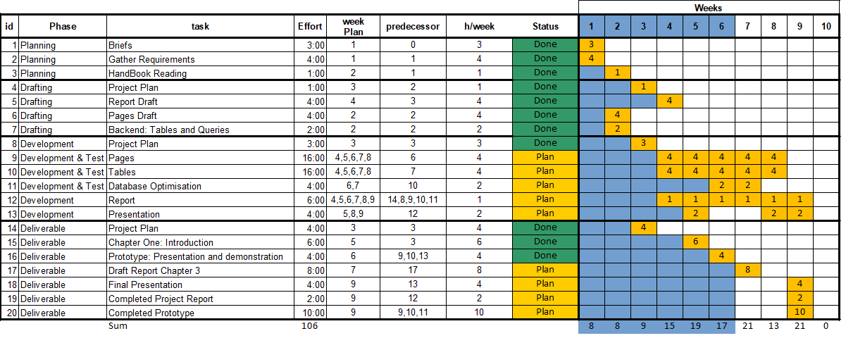
Ger’s Garage WebSystem Progress details
Eduardo Nakashima
SB18004
Notes:
Report
Skeleton
Chapter 1
Chapter 3
Development
Database
Users
Vehicles
Engine
Make
Booking
Roster
Invoice
Parts
Services
Pages
Welcome
Register
Login
Vehicle register
Booking schedule
Booking status
Invoice

Slide 4
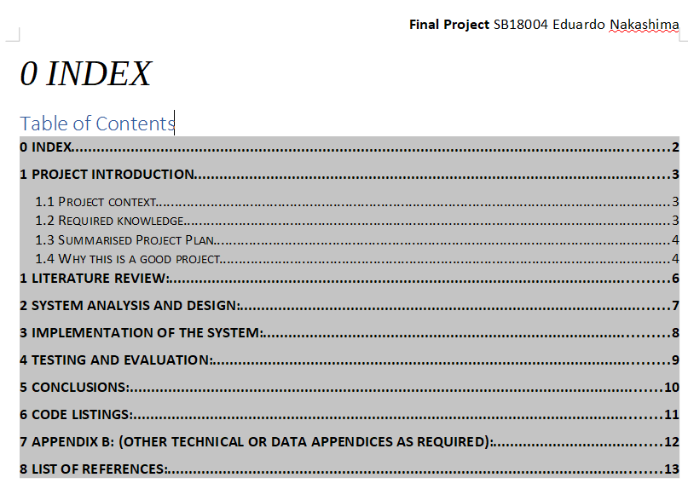
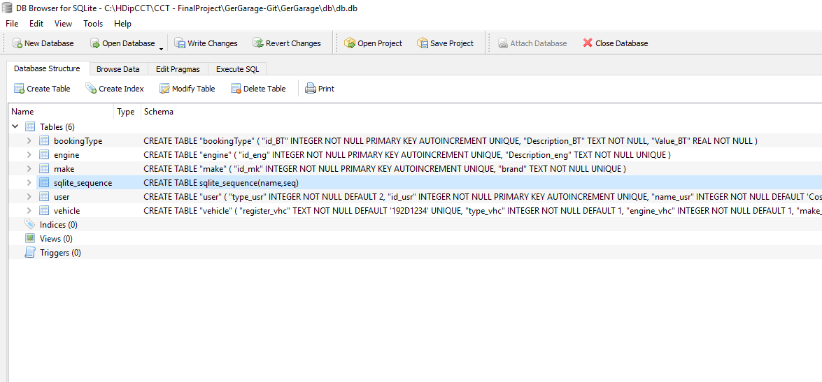
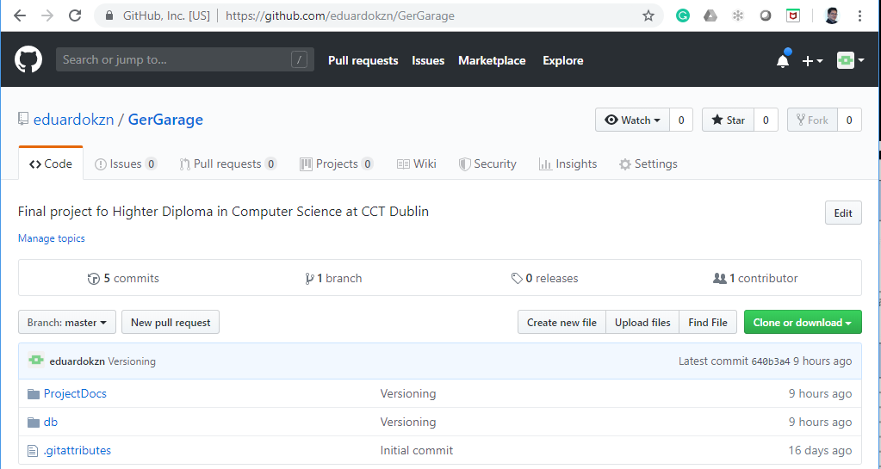
Ger’s Garage WebSystem Progress details
Eduardo Nakashima
SB18004
Report Structure
SQLite Design tools
Webdesign and SQLite
Notes:
Report
Skeleton
Chapter 1
Chapter 3
Development
Database
Users
Vehicles
Engine
Make
Booking
Roster
Invoice
Parts
Services
Pages
Welcome
Register
Login
Vehicle register
Booking schedule
Booking status
Invoice

Slide 5
Ger’s Garage WebSystem Next steps
Eduardo Nakashima
SB18004
Report
Chapter 2
Chapter 3
Development
Database
Booking
Roster
Invoice
Parts
Services
Pages
Welcome
Register
Login
Vehicle register
Booking schedule
Booking status
Invoice
Integration web and database
Research on Webdesign tools / framework

